Slide 1
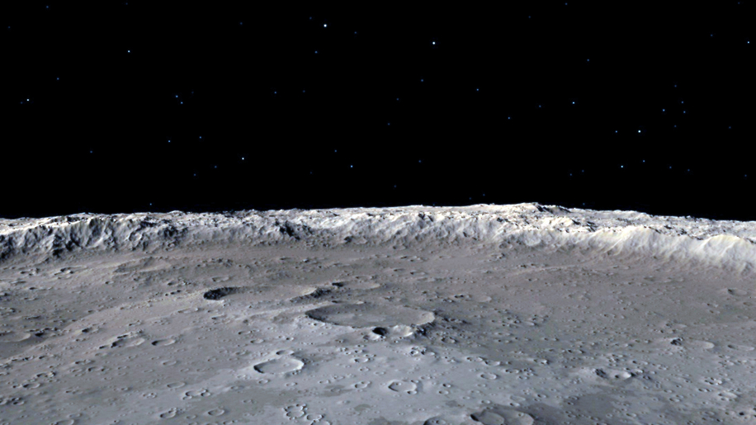

The Spatial Web
HSML schema and how to apply it to Kafka
Alicia Sanjurjo Barrio (349B – Affiliate)
11/22/2024

Slide 2
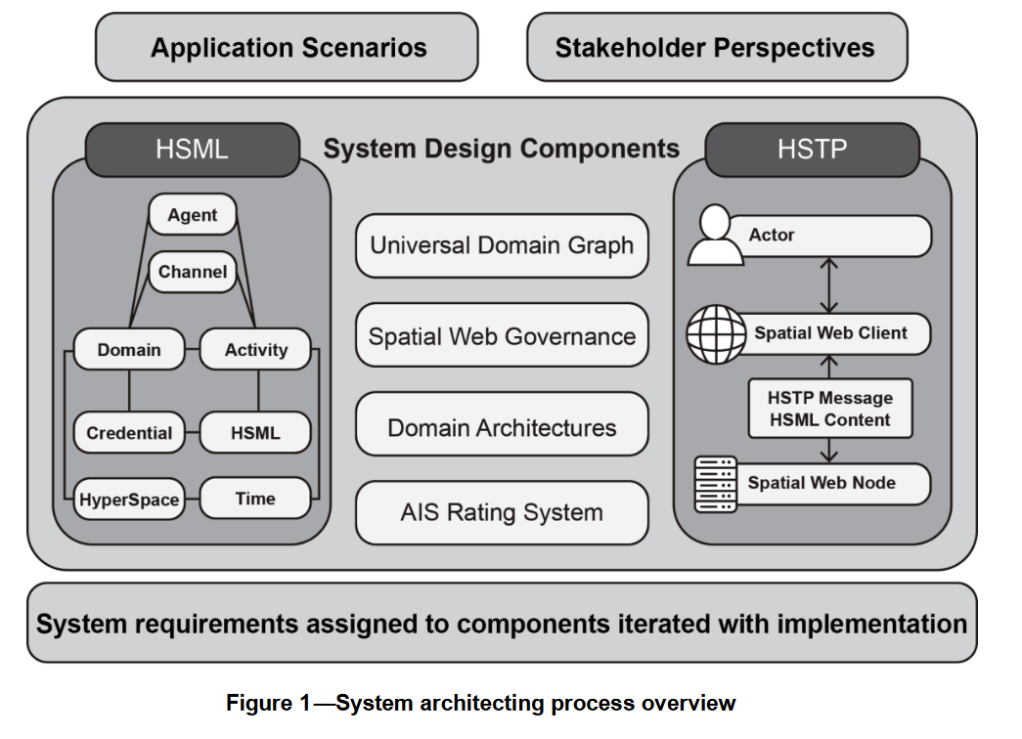
Spatial Web Architecture
The Spatial Web specification applies an architectural design approach to the Spatial Web System.
The architecture components are:
Hyperspatial Modeling Language (HSML),
Hyperspatial Transaction Protocol (HSTP),
Universal Domain Graph (UDG),
Spatial Web Governance,
Domain-specific Architectures, and
Autonomous Intelligent Systems (AIS) Rating System
From 979-8-3503-5597-0/25/$31.00 ©2025 IEEE,
Enabling Interoperable Digital Twins for Collaborative Lunar Exploration
Notes:
Universal Domain Graph (UDG): Distributed metagraph containing all relationship
information between all known Domains in the Spatial Web.

Slide 3



Spatial Web Protocols
HSML ≡ Hyperspace Modeling Language
  A multi-dimensional ontology for encoding fundamental elements and the relationships between them.
HSTP ≡ Hyperspace Transaction Protocol
  A multi-dimensional range query for governing the interactions between actors and assets
HSQL ≡ Hyperspace Query Language
  Syntax for performing predictive (probabilistic) queries on a vector graph document database which combines comparative, relational, and similarity searching

Slide 4
HSTP in Simple Words
HSTP ≡ Hyperspace Transaction Protocol
System designed to enable smooth, decentralized, secure, and private communication
Focuses on transactions (exchanges of information or actions)
The HSTP Objects are "units of activity". Each object represents an action or event (called an HSML Activity)
Allows different Spatial Web nodes to exchange messages and stay coordinated.
  HSTP does for the Spatial Web as HTTP does for the WWW

Slide 5

HSTP & HSML for Kafka
Kafka Integration: Create protocols for authentication and authorization aligned with HSTP principles.
Authentication of users required to access the server
  Can use SSL/TLS or SASL
Authorization needed to participate in different channels
  Kafka Topics with restricted access using ACLs.
Message Content: Kafka messages would carry data structured in HSML
Possible resources to consider:
https://medium.com/@bhattchitrangna/securing-your-kafka-a-beginners-guide-to-kafka-security-ab2978a4d82e
https://www.redpanda.com/guides/kafka-cloud-kafka-authentication
https://developer.confluent.io/courses/security/authorization/
https://docs.confluent.io/platform/current/security/authorization/acls/overview.html

Slide 6
HSML in Simple Words
HSML ≡ Hyperspace Modeling Language
A modeling language that can be read by both humas and machines
A detailed schema/map that explains how all the different data is related to each other in the system
It describes objects, relations, actions, activities and their permissions
  HSML does for the Spatial Web as HTML does for the WWW

Slide 7
Spatial Web Ontology Entries
ENTITIES are the base items used across the Spatial Web in HSML
The Spatial Web ontology defines several classes. All classes are types of the Entity base class:
ACTIVITY
AGENT
CONTRACT
CHANNEL
CREDENTIAL
DOMAIN
HYPERSPACE/SPACE
TIME
HSML encodes ENTITIES in a format, e.g., JSON

Slide 8
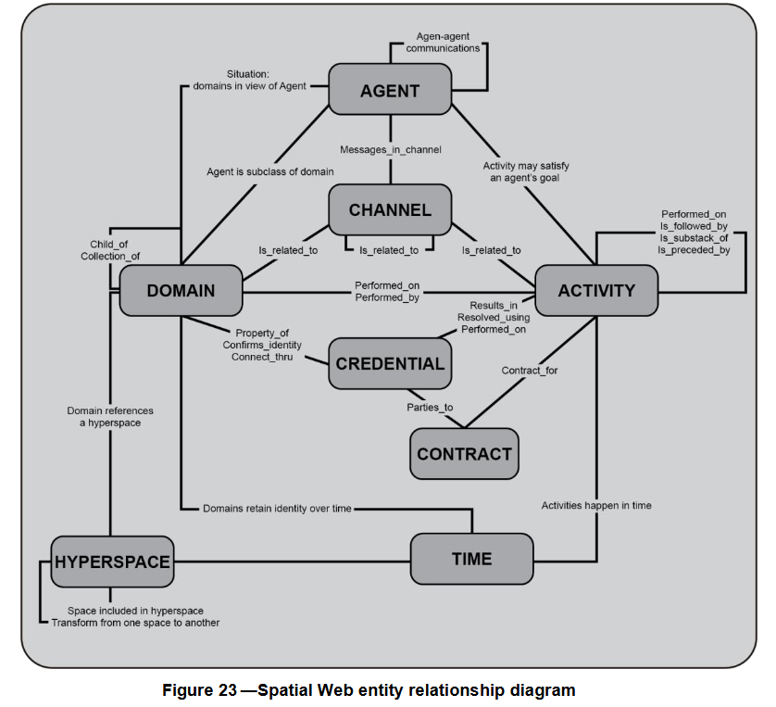
From P2874/D3.1, June 2024 Draft Standard for Spatial Web Protocol, Architecture and Governance:

Slide 9
Agent has goals, senses, and responds, i.e. Lunar Rover
AGENT
Agent is a type of Domain. Agents can also sense other Domains
Activity is an action performed by an Agent
Agent can send messages through
the Channel
i.e. Lander, Rover, Moon surface
A Domain info can be sent through the Channel
CHANNEL
Channel contains messages related to an Activity
i.e. Leave the Lander
DOMAIN
ACTIVITY
A Domain can perform an Activity.
An Activity can be performed on a Domain
Domain references a Hyperspace
A Credential is made by a Domain (domain authority)
A Contract is done for an Activity
Activities take Time to be carried out
A Credential parties to a Contract
CREDENTIAL
CONTRACT
HYPERSPACE
TIME
Notes:
HYPERSPACE: A set of ‘points’ such that, for every ordered pair of points, there is a possibly empty set of ‘paths’ from the first point to the second, and such that there is an ‘identity’ path from every point to itself. Syn: SPACE.

Slide 10
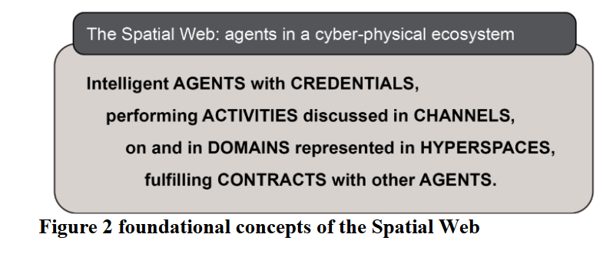
In summary,
From 979-8-3503-5597-0/25/$31.00 ©2025 IEEE,
Enabling Interoperable Digital Twins for Collaborative Lunar Exploration

Slide 11
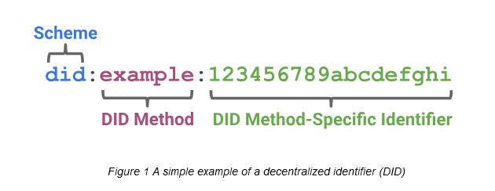
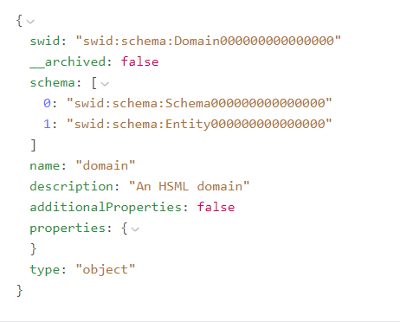
Attributes of HSML ENTITY
Identifiers – SWIDs¹ that conform to W3C did-core, https://www.w3.org/TR/did-core/.
Name
Description
Links to other ENTITIES
Properties
Type: either “ENTITY” or one of the eight semantic entities in the Spatial Web ontology
All HSML objects derive from the Entity class.
¹SWID ≡ Spatial Web Identifier

Slide 12
HSML Example Explained
Entity Subclass: Domain
To which entities is connected/linked
Status: Active or in use within the system
Given name to that domain
It should be Domain for this case
¹SWID ≡ Spatial Web Identifier

Slide 13
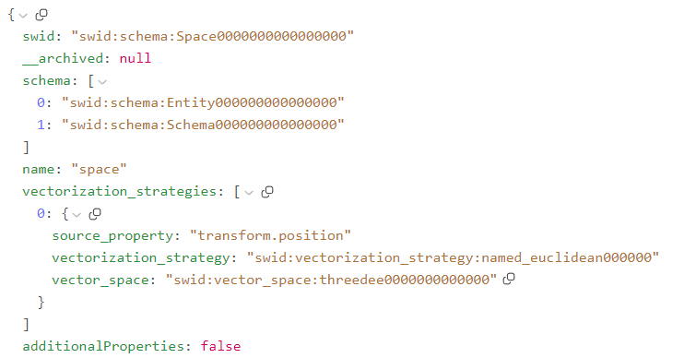
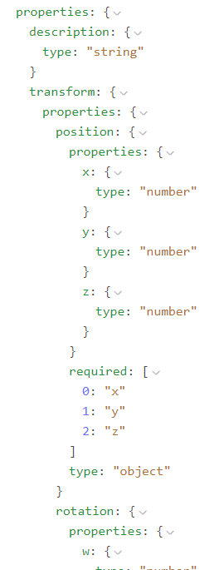
HSML Example Explained
To which entities is connected/linked
Entity Subclass: Space
Achival Status: not defined
Given name to that space
Specific to Space subclass
¹SWID ≡ Spatial Web Identifier

Slide 14
HSML Scene
The HSML Scene allows to display meshes in a scene, place and rotate them.
There are currently 2 proposals:
Proposal A:
  The whole scene is contained in a single object. Can be retrieved in a single call.
  Easier to go from these HSML meshes to USD, closer to the logic of NVIDIA and similar tools.
  Needs to update the whole scene.
Proposal B:
  Each scene or mesh in an HSML entity. All need to be retrieved, using a few HSQL queries.
  Implemented in a more HSML-like manner with scenes composed of linked entities
  Can access/update individual entries more easily and not the entire scene.

Slide 15
ADDITIONAL SLIDES

Slide 16
DOMAIN Types
There are 6 types of Domains:
Geographic — ex: Moon surface
Concept — ex: Planetary Protection
Organization — ex: a JPL team workplace
Agent — ex: a physical rover, a digital twin, a lander
Person — ex: a human person, astronaut
Thing — ex: lunar rocks, the lander’s platform

Slide 17
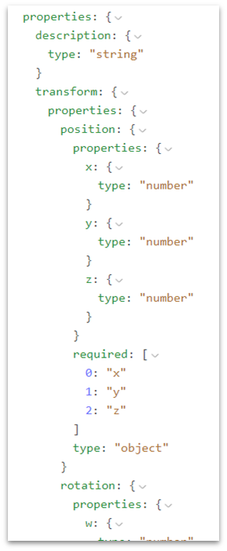
SPACE Properties
There are different properties that can define a SPACE:
description
transform
position (xyz)
rotation (xyz)
volume (xyz)

Slide 18
HSTP Queries
Bootstrapping/Context queries
Activity queries
Hyperspace range queries
Abstract data type query
Graph queries
Semantic queries
Vector queries
Queries on HSML Entitites

Slide 19
HSML Mesh
An HSML Mesh is an HSML document, it contains:
The meshes field – mesh URIs pointing to stored files in S3 bucket (i.e. a mesh in USD for Nvidia Omniverse)
The volume field – contains nodes field (octree of mesh)

Slide 20
Channel 1
User 1
User 2
Channel 2
User 3
User 4
Channel 3
User 5
User 6

